Slide 1

Autonomous Operation for Last-Mile Delivery on Suburban Sidewalk
RBE550-Project Update
Keith Chester/Bob DeMont
Notes:
Hello and welcome to an update on our RBE550 project for Autonomous operations for last mile delivery on an urban sidewalk

Slide 2

A Couple of Changes
“No plan of operations extends with any certainty beyond the first encounter with the main enemy forces.”
-Prussian Field Marshal Helmuth von Moltke the Elder, 1871
With the extensive learning in Pygame for the homeworks and relatively little time left for learning ROS/Gazebo, we changed tools.
ROS/Gazebo out, Pygame in.

Slide 3
Goals
Our goals came into focus over the course of the lessons as we explored various search techniques.
Original Goals
Revised Goals
Planning and execution algorithms
Autonomous navigation
Obstacle avoidance
Static obstacles (boxes, trashcans)
Dynamic obstacles (people bikes)
Sidewalk rules
Staying on sidewalk
Crossing at crosswalk at green light
Simulation visualization in Gazebo
Planning and execution algorithms
Autonomous navigation
Global planner for high level navigation
Local planner for kinematic movement and obstacle avoidance
Obstacle avoidance
Static obstacles (boxes, trashcans)
Dynamic obstacles (cars)
Sidewalk rules
Staying on sidewalk
Notes:
AS noted in the previous proposal, we have proposed to design and simulate autonomous navigation along an urban sidewalk for last mile delivery of items like groceries. We plan to follow sidewalk rules, staying on the sidewalk, crossing at crosswalks and not veering into the street. We are planning for both the common static obstacles one might encounter such as dumpsters, construction cones, fire hydrants and cardboard boxes as well as dynamic obstacles such as other delivery bots or people.

Slide 4
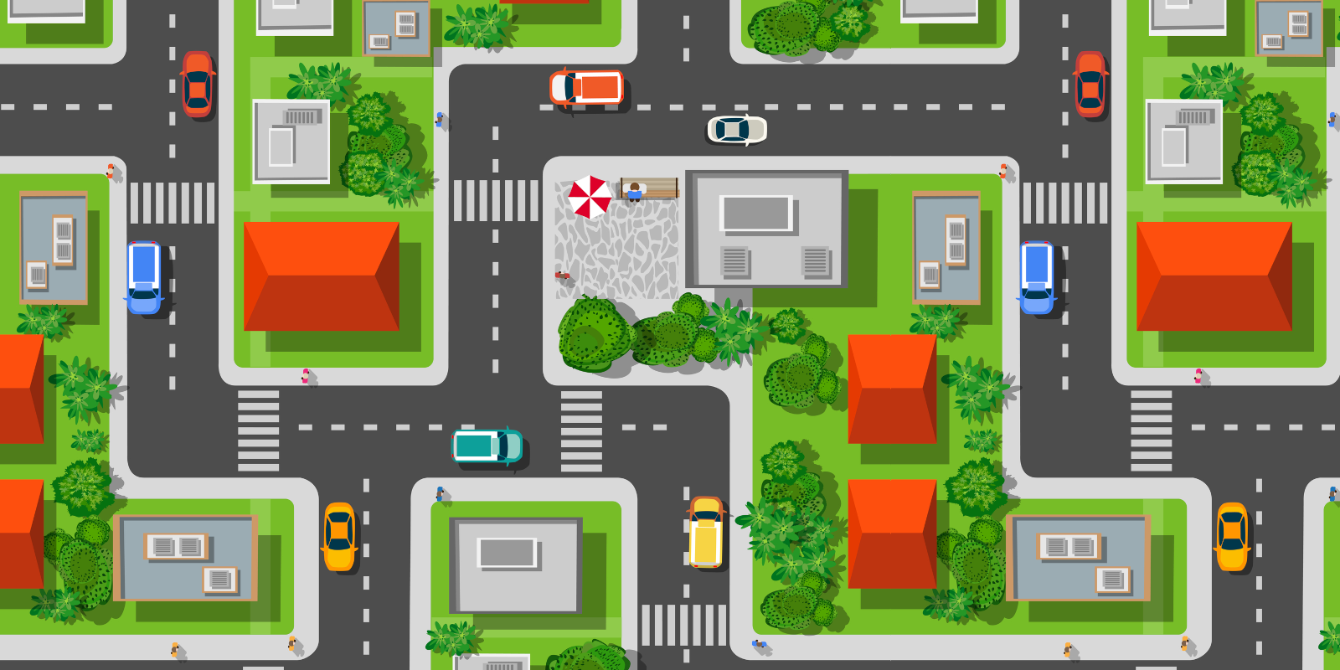
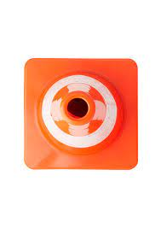
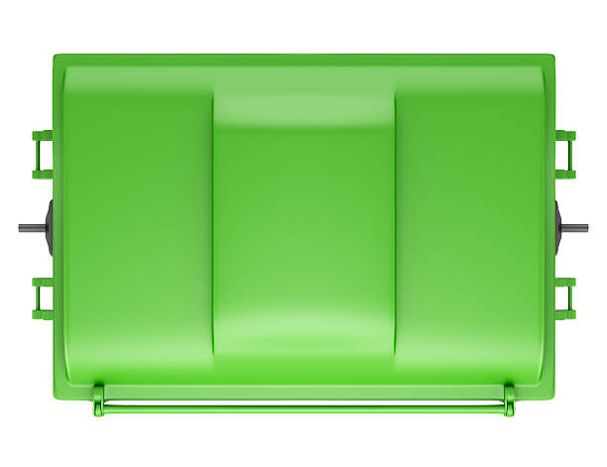
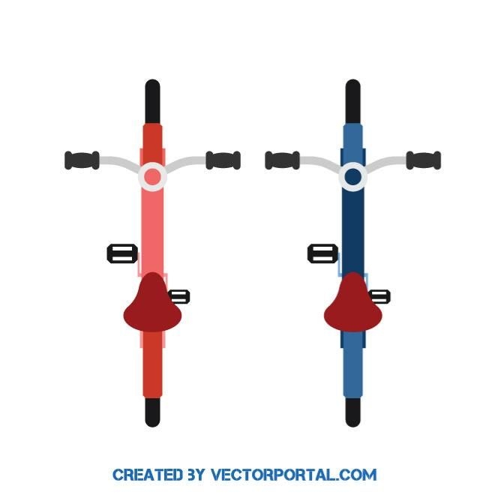

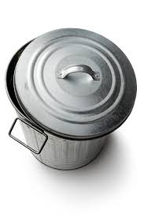
Our Environment
Trashcans
Vehicles
Cones
Dumpsters
Bikes
Notes:
We continue to be on our planned schedule. Because of the newness of the tools to both of us, we have spent the past 3 weeks studying both ROS and Gazebo as well as setting up the programming environment. During this time we also explored the use of Docker as a development tool. We began by referencing wikis maintained by the ROS organization to get our initial images configured and followed that with reading several blogs and sources attempting to find a balance of ease of approach with industry best practices. Keith later posted a detailed document for others outlining this in the discussion forum.
As part of the learning, Keith has also been working hard at learning the internals of the ROS Navigation Stack, URDF/XARCO modeling for Gazebo, and Gazebo world creation.

Slide 5
Our Hero
Our delivery bot (Delbot) didn’t scale well but he’s there in sprite – I mean spirit!

Slide 6
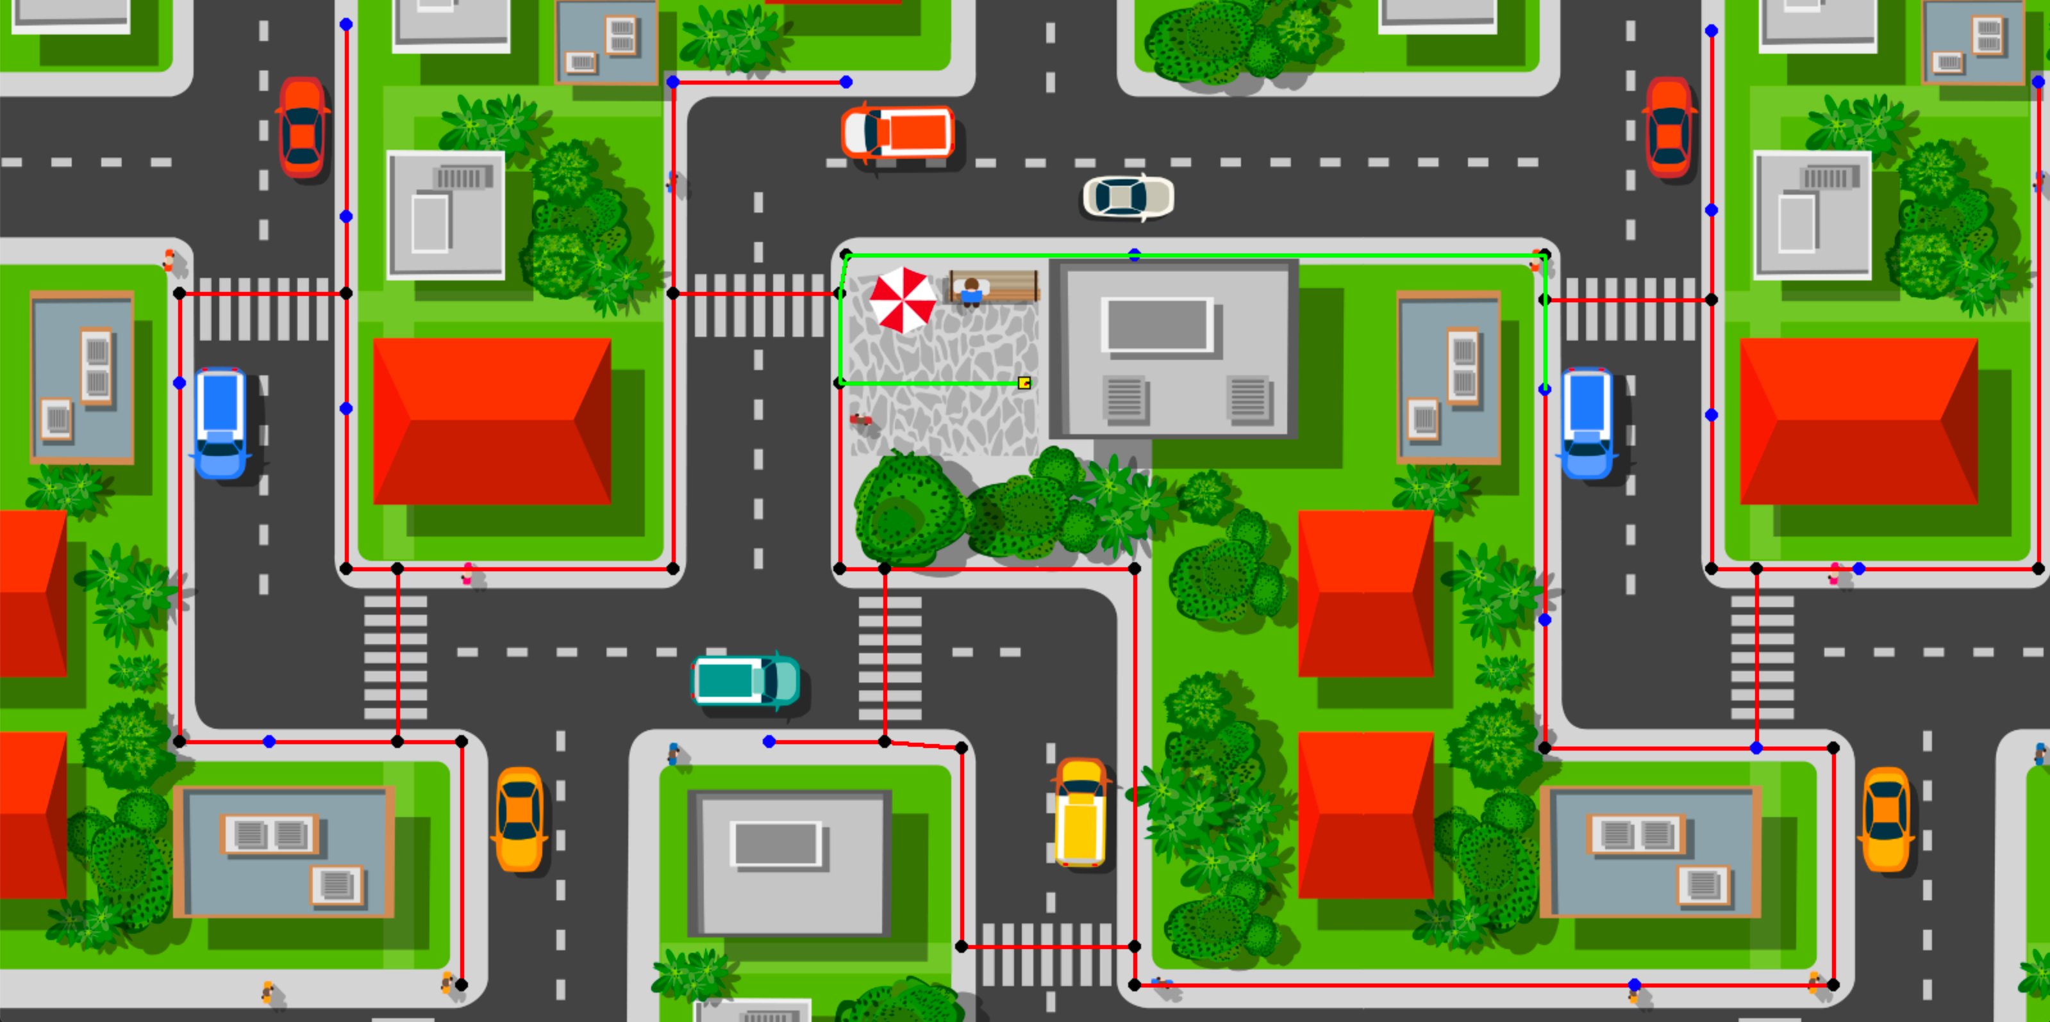
Approach
Global planner for the shortest path/local planner for movement
All nav aids/waypoints mapped and classified as corners, crosswalks and delivery addresses.
Known navigation map
Permitting an A* optimal search for shortest route to a delivery address
Here our hero is ready at the store
Crosswalks and corners marked in black
Delivery addresses in blue

Slide 7
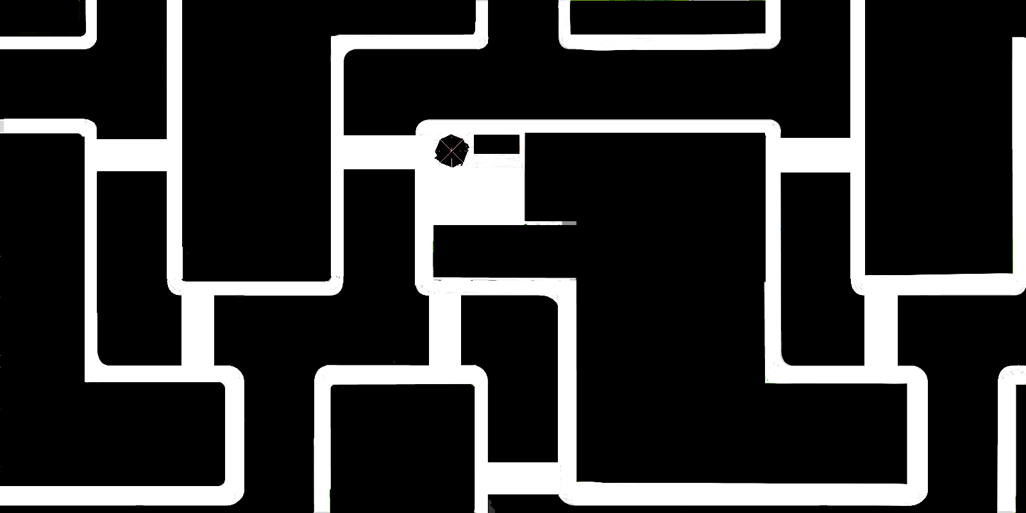
Approach-2
After the global planner determines the best path the local planner executes the movement.
We modelled diwheel kinematics to execute movement.
Collisions were detected on a shadow layer of the game using Pygame sprites and alpha layers (obstacles and their masks randomly inserted for each run)

Slide 8
Results
We currently have :
the environment complete
Collisions working
Random delivery addresses generating
Global planning selecting optimized route

Slide 9
More Exploration
Over the rest of the week we plan to:
Complete debugging of the local planner
Add randomized environmental obstacles
-To the visual environment
-as well as the collision environment
Generate moving obstacles (cars)

